Slide 1
Project 1
Impact of Insurance and Income on Heart Disease Mortality
Abdulla Mashaly, Elijah Reid, Hannah Doby, and Rebecca Balderas

Slide 2

Project Study
Heart Disease is the leading cause of death in the United States for both men and women.
Our team was interested in how heart disease and mortality from heart disease was illustrated in North Carolina.
If an individual has insurance, are they less likely to die from heart disease?
Is an individual in a higher income bracket more likely to be insured?
Does the total population in a given county correlate with the amount of individuals insured?
Hypothesis
Alternative hypothesis: The lower income population is less likely to be insured
Null hypothesis: Income levels have no affect on percentage covered

Slide 3
Data Sources
Centers for Disease Control
United States Census Bureau – Small Area Health Insurance Estimates

Slide 4
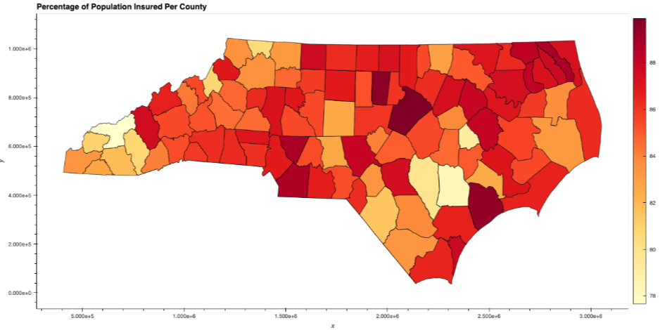
1.1 If an individual has insurance, are they less likely to die from heart disease?

Slide 5
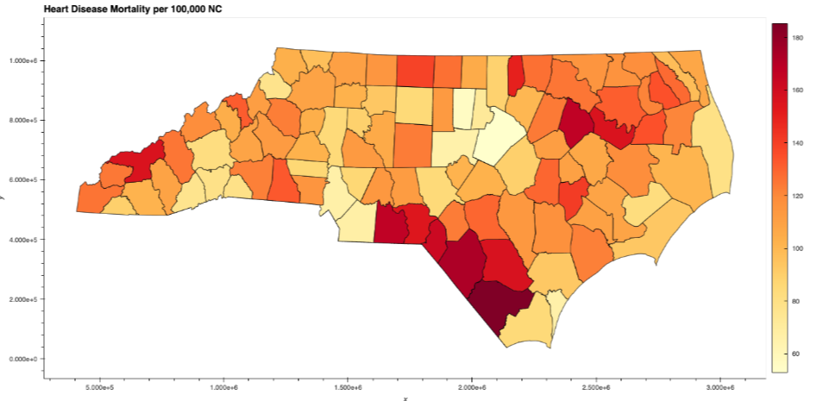
1.2 If an individual has insurance, are they less likely to die from heart disease?

Slide 6
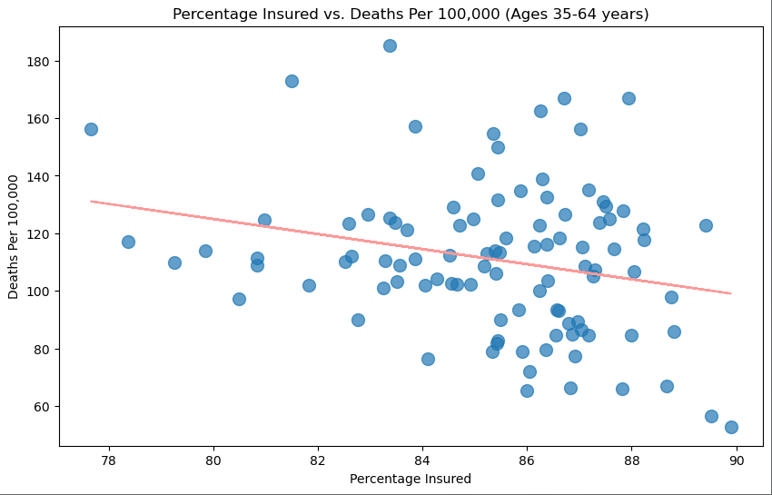
1.3 If an individual has insurance, are they less likely to die from heart disease?
The scatter plot to the right illustrates the correlation between individuals who have insurance and heart disease mortality.
R Value = -0.24

Slide 7
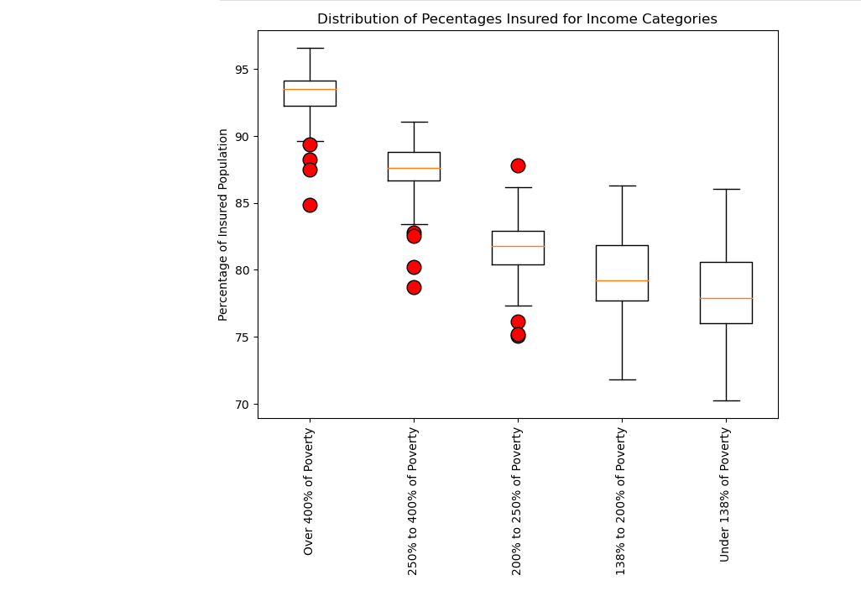
2. Is an individual in a higher income bracket more likely to be insured?
The box plot visual supports our hypothesis that individuals with higher income are more likely to be insured.
Pvalue=1.171103111221553e-80

Slide 8
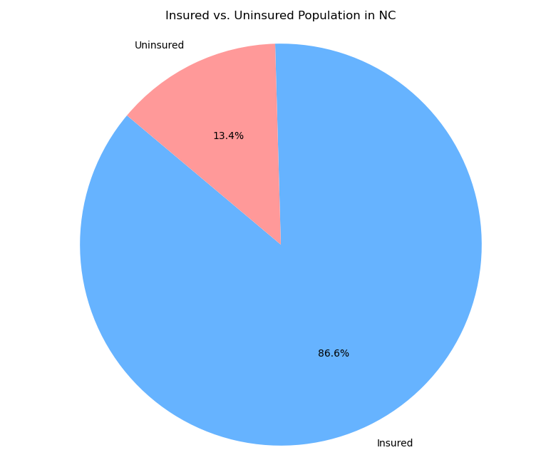
3.1 Does the total population in a given county correlated with the amount of individuals insured?

Slide 9
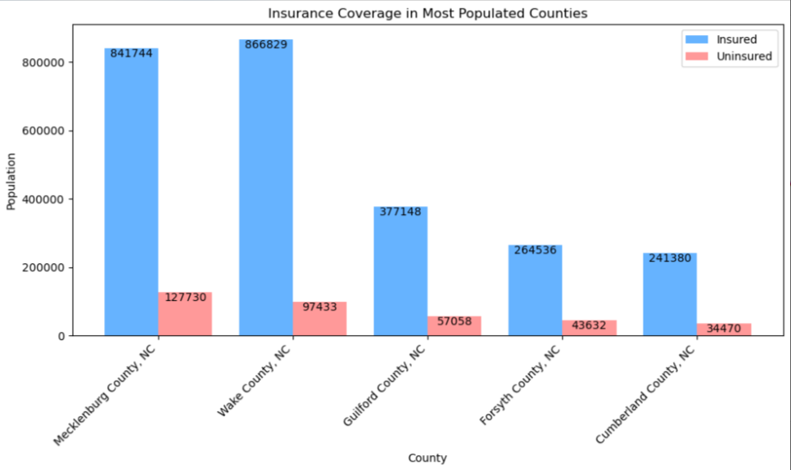
3.2 Does the total population in a given county correlated with the amount of individuals insured?
There is a positive correlation to higher population with more individuals insured.

Slide 10
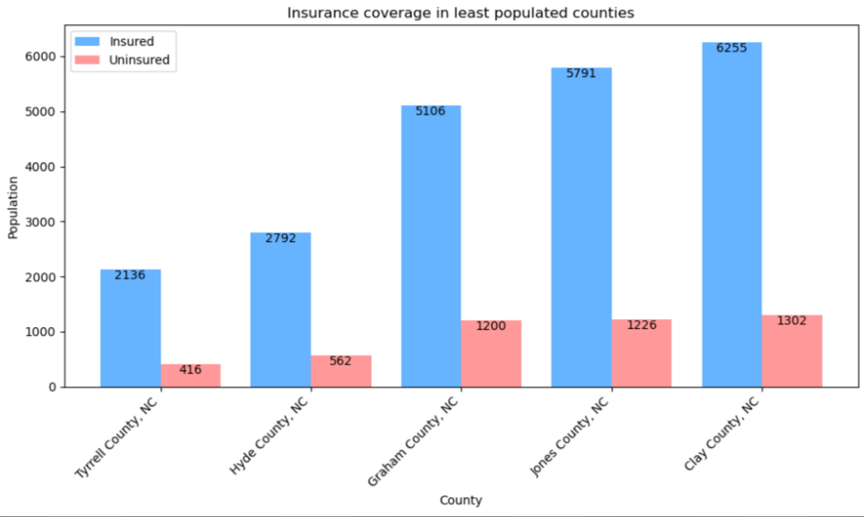
3.3 Does the total population in a given county correlated with the amount of individuals insured?
There is a positive correlation to least populated and less individuals insured.

Slide 11
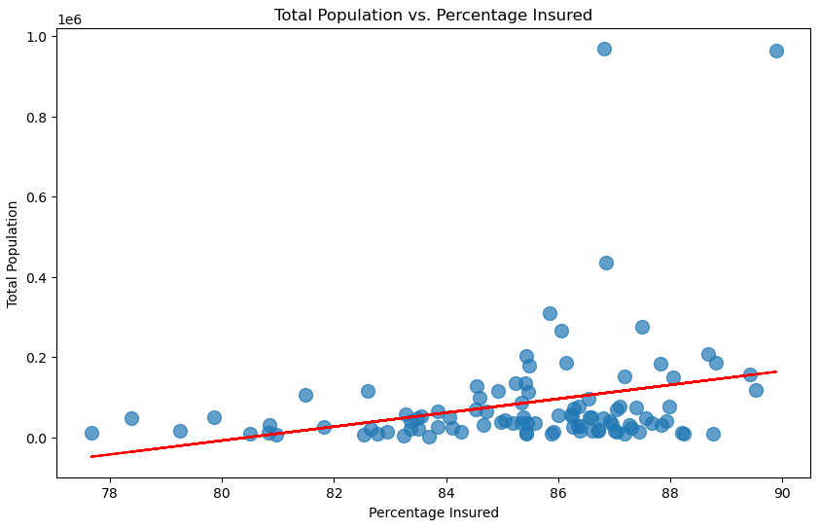
3.4 Does the total population in a given county correlated with the amount of individuals insured?
The scatter plot to the right illustrates the relationship between NC counties’ population and individuals insured.

Slide 12
Conclusion
1. There is not enough to prove that if an individual has insurance, that they are less likely to die from heart disease.
2. There is a positive correlation between an individual with a higher income and more likely to be insured.
3. There is a minor correlation between more populated counties and the number of insured individuals but there isn’t enough to demonstrate significance.

